Slide 1
Models in django
Django mastery course in Nepali

Slide 2


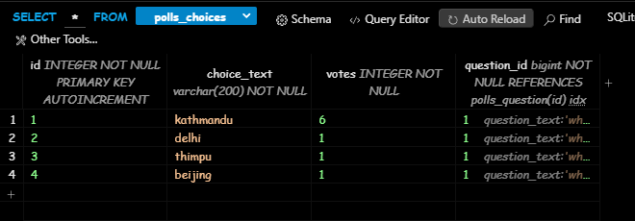
Models
A model is the single, definitive source of information about your data. It contains the essential fields and behaviors of the data you’re storing. Generally, each model maps to a single database table.
The basics:
• Each model is a Python class that subclasses django.db.models.Model.
• Each attribute of the model represents a database field.
• With all of this, Django gives you an automatically-generated database-access API;
from django.db.models import models
class [ model_name](models.Model):
field_name = models.Field_class(attributes)
class meta:
pass
Database
Table

Slide 3
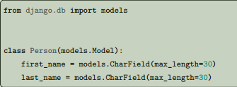
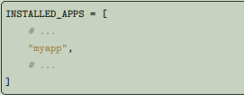
Using models
Once you have defined your models, you need to tell Django you’re going to use those models. Do this by editing your settings file and changing the INSTALLED_APPS setting to add the name of the module that contains your models.py. For example, if the models for your application live in the module myapp.models (the package structure that is created for an application by the manage.py startapp script), INSTALLED_APPS should read, in part:
first_name and last_name are fields of the model. Each field is specified as a class attribute, and each attribute maps to a database column.
When you add new apps to INSTALLED_APPS, be sure to run manage.py migrate, optionally making migrations for them first with manage.py makemigrations.

Slide 4
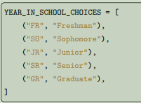
Fields
The most important part of a model – and the only required part of a model – is the list of database fields it defines. Fields are specified by class attributes. Be careful not to choose field names that conflict with the models API like clean, save, or delete.
Field types
Each field in your model should be an instance of the appropriate Field class. Django uses the field class types to determine a few things:
• The column type, which tells the database what kind of data to store (e.g. INTEGER, VARCHAR, TEXT).
• The default HTML widget to use when rendering a form field (e.g. <input type="text">, <select>).
• The minimal validation requirements, used in Django’s admin and in automatically-generated forms.
Django ships with dozens of built-in field types; you can find the complete list in the model field reference.
Field options
Each field takes a certain set of field-specific arguments (documented in the model field reference). For example, CharField (and its subclasses) require a max_length argument which specifies the size of the VARCHAR database field used to store the data. There’s also a set of common arguments available to all field types. All are optional.
null
If True, Django will store empty values as NULL in the database. Default is False.
blank
If True, the field is allowed to be blank. Default is False.
Note that this is different than null. null is purely database-related, whereas blank is validation related. If a field has blank=True, form validation will allow entry of an empty value. If a field has blank=False, the field will be required.
choices
A sequence of 2-value tuples, a mapping, an enumeration type, or a callable (that expects no arguments
and returns any of the previous formats), to use as choices for this field. If this is given, the default form
widget will be a select box instead of the standard text field and will limit choices to the choices given.
A choices list looks like this:
The first element in each tuple is
the value that will be stored in
the database. The second
element is displayed by the
field’s form widget.

Slide 5
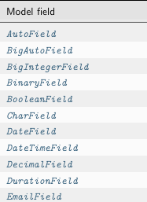
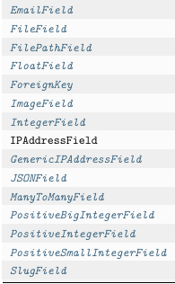
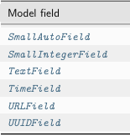

Slide 6
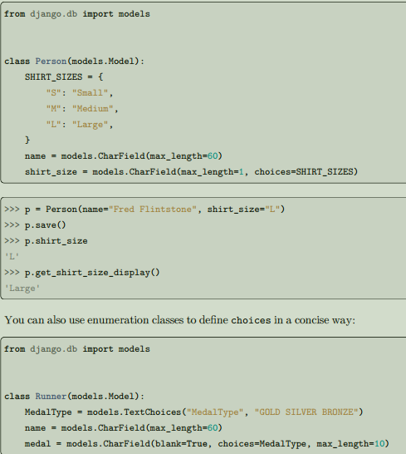
default
The default value for the field. This can be a value or a callable object. If callable it will be called every
time a new object is created.
help_text
Extra “help” text to be displayed with the form widget. It’s useful for documentation even if your field
primary_key
If True, this field is the primary key for the model.
If you don’t specify primary_key=True for any fields in your model, Django will automatically add an IntegerField to hold the primary key, so you don’t need to set primary_key=True on any of your fields unless you want to override the default primary-key behavior.
unique
If True, this field must be unique throughout the table.

Slide 7
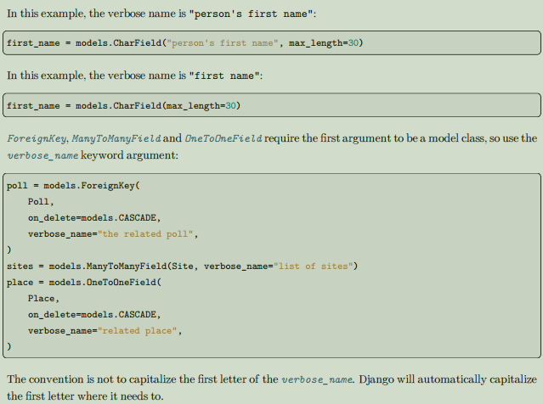
Verbose field names
Each field type, except for ForeignKey, ManyToManyField and OneToOneField, takes an optional first positional argument – a verbose name. If the verbose name isn’t given, Django will automatically create it using the field’s attribute name, converting underscores to spaces.

Slide 8
Break………… done

